Slide 1
AES Program Reflection Process Webinar
Dereck Norville-Bowie, Associate Director
Office of Institutional Effectiveness, Research, and Assessment (OIERA)
September 22nd, 2020

Slide 2
Agenda
Time | Agenda Item
12:00 – 12:05 | Welcome and Settling In
12:05 – 12:10 | Brief History of AES Assessment at Hostos Goals of the Newly Redesigned Process
12:10-12:25 | Highlights of the Revision Process Overview of AES PR Process & Process Timeline
12:25 – 12:30 | Supports for the Process Key Roles
12:30 – 12:45 | Questions and Answers
Notes:
I am going to try to move rather quickly through the presentation aspect so that there’s more time for questions later. If questions emerge for you as I’m going through the presentation portion, please drop them in the chat. While I don’t prefer to spend much of the time hearing myself talk, I recognize that you’re all here to learn about what this redesigned process is, so I will be sharing that information.

Slide 3
Recording
Notes:
There are folks who wanted to, who could not join today. I will be recording this webinar so that I may share it back out with all of you and for those who couldn’t join. I’m letting you all know, because I know being recorded is not everyone’s preference, so you can feel free to either turn your camera off or exit, if this makes you uncomfortable; I will totally understand.
I will start the recording now.

Slide 4
History of Assessment in AES Units
Non-Academic Program Review Process – 2013
Revision to Non-Academic Program Review Process - 2017
Notes:
At Hostos, assessment of units and programs had been done in the Division of Academic Affairs for decades (gen ed assessment, academic program reviews, etc.) . . . But not in any of the other divisions of the college. This changed in 2013, with what was then called the Institutional Assessment Plan (IAP). That plan outlined a new assessment process for, what was then called, “non-academic” programs, which was modeled after the already existent APR. Then, in 2017 this process was revised.

Slide 5
POLL
Notes:
Before I go further, I’d love to get a quick pulse check of how much all of you know/knew about the former Non-APR process. On your screen, you should now see a quick poll; please take a few seconds and submit your response; I’ll give everyone a minute.

Slide 6
APR vs. Non-APR
Academic Program Review (APR)
Non-Academic Program Review (Non-APR)
A study of program effectiveness that goes beyond the assessment of student learning to examine:
administrative effectiveness,
relevance of course offerings to industry standards,
instructional and student support services, and
adequacy of faculty and staff.
A study of individual offices, programs, or initiatives that are not specifically academic in nature to assess:
operational effectiveness and efficiency;
direct or indirect impact on student success; and
adequacy of staff and resources.
Notes:
Many of you are probably familiar with Academic Program Review and what we want to highlight is that the APR and Non-APR processes are actually quite similar

Slide 7
Non-APR in a Nutshell
Phases of Non-APR Process
Self-Study Phase
External Review Phase
Implementation
Phase
Notes:
First Year - the self study document (which encompasses a number of different components, which we will talk about in a few minutes) will be completed in this year.
Second Year - external reviewer conducts a review of the document and related materials, visits the campus, and prepares a final report.
Third Year - recommendations from non-APR self-study and/or the external review report are put into effect.
This is intended to be a cycle of continuous improvement.

Slide 8
The Cycle
Self-study
Year One
VP
External Evaluator
Year Two
Program and VP
Implement-ation
Year Three
Two Year Hiatus

Slide 9
Reasons for Redesigning
Notes:
The former process was time-consuming
The former process was report-focused
There was little space and/or too few structures for meaningful reflection and discussion
With the roll-out of the Annual Report Template, there was an opportunity to revisit the utility of the process and consider how an AES Program Review Process could complement the annual reporting process (and is not a disconnected, add-on to that process)

Slide 10
Goals of the Redesign
Pivot away from a report- and administratively-focused process toward a more reflective, improvement-focused process
Leverage the annual reporting process (Not be a superfluous add-on)
Make the outputs of the process more meaningful to AES units
Notes:
Pivot away from a report- and administratively-focused process toward a more reflective, improvement-focused process
Leverage the annual reporting process, which is already focused on unit/program outcomes as well as assessment of ILOs, to engage in deeper reflection and strategy building that is based on a holistic assessment of the unit/program’s progress to date and where it wants to be in the future.
Make the outputs of the process more meaningful – Having a polished, comprehensive report may be meaningful or beneficial to other entities, but units themselves don’t necessarily need (or benefit from) that

Slide 11
Highlights of Redesign
Focus is shifted from “Product” to “Process” (Reflection)​
Process has been intentionally renamed
Designed to leverage the learning from the annual reporting process and feedback into it​
Provides structured guidance for individual and group reflection/assessment via structured discussions​
Designed to be reasonably undertaken in one semester (Fall)​
Notes:
Before diving in, a few highlights of this redesigned process
Focus is shifted from “Product” to “Process” (Reflection)​ - No More polished report, but there IS template document that needs to be completed
Language matters . . . And the Process has been intentionally renamed to signal the shift in focus​; AES units and programs are not “under review”; AES units are taking time to reflect on their own units.
Designed to leverage the learning from the annual reporting process and feedback into it​
Provides structured guidance for individual and group reflection via assessment and structured conversations​
Designed to be reasonably undertaken in one semester (Fall)​, which units would undertake once every 4 years​

Slide 12
AES PR Process Overview
AES Program Reflection Process is broken down into 4 parts:​
​
Component | Description | Timeframe
Part 1 | Review of previous years’ annual reports and team discussions | August - September
Part 2 | Co-development of draft template document (based on assessment and reflection)​ | September
Part 3 | External feedback conversations to revise and refine the template​ | October - November
Part 4 | Using the template to complete annual report template and implementing your new plan | November - December
Notes:
SO LET’S TALK ABOUT WHAT THIS AES PROGRAM REFLECTION PROCESS LOOKS LIKE!!

Slide 13
Part 1 – Review of Previous Years’ Annual Reports
Steps | Who | Resources/ Templates | Timeframe
Reviews of previous years’ annual reports and other relevant data Discussion(s) to unpack learnings and brainstorming about future direction | Entire unit team Entire unit team, led by unit leader(s) | Guiding Questions and Prompts for Team Members’ Individual Assessment Facilitation guide (for team member leading brainstorming and discussion) | August - September
Notes:
For each component, there is a breakdown of the steps involved, who is engaged in those steps, and the resources to support it. For example . . .

Slide 14
Part 2 – Co-Development of Template Document
Steps | Who | Resources/ Templates | Timeframe
Completion of first draft of AES PR template | Unit Team designee (Likely unit leader[s]) | AES Program Reflection Template | September
Notes:
Part 2 is simply the completion of a first draft of the template, based on those unit team discussions. The template itself maps out which sections should be completed, when.

Slide 15
Part 3 – Feedback and Revision
Steps | Who | Resources/ Templates | Timeframe
Gather feedback from entity outside of the unit and then through a conversation with division leadership Revisions to draft template (if needed) and then finalizing document, before uploading to shared platform (TBD) Participation in a cross-unit activity to celebrate learning and identify potential areas of collaboration. | Unit leader(s), external entity, & Division leader Unit leader(s) Unit Team | Guidance document for seeking external guidance Facilitation guide (for divisional leadership leading feedback conversation) | October - November

Slide 16
Part 4 – Implementation and Management
Steps | Who | Resources/ Templates | Timeframe
Use template document to draft annual report template for upcoming academic year Assignment of roles and responsibilities for upcoming annual report template Implementation of new plan | Unit team, led by unit leader(s) Unit leader(s) Unit team | MOCHA Framework Document | November - December

Slide 17
Primary Roles & Responsibilities
Who | Responsibilities
OIERA | Develop and communicate resources to support the AES PR process Provide training and support to unit, department, or program leadership undergoing AES PR Provide data guidance and support, as needed
Unit Leadership | Lead unit team through reflection, assessment, and brainstorming process Seek feedback and thought partnership on proposed direction Complete template document Ensure template document informs following year’s annual report template
Division Leadership | Support unit leadership through AES PR process Encourage prioritization of the AES PR process Provide feedback and thought partnership on unit direction (based on unit reflection, operational priorities, and college-wide priorities)

Slide 18
Supports for the Process - Resources
There are a few key documents that have (or will be) drafted to capture or support this process​
To Capture:​
Template Document​
To Support:​
Guiding questions and prompts for individual reflection​
Facilitation guide for leading team discussions
Guidance document for seeking external feedback
Facilitation guide for divisional leadership to lead discussion (In development)​

Slide 19
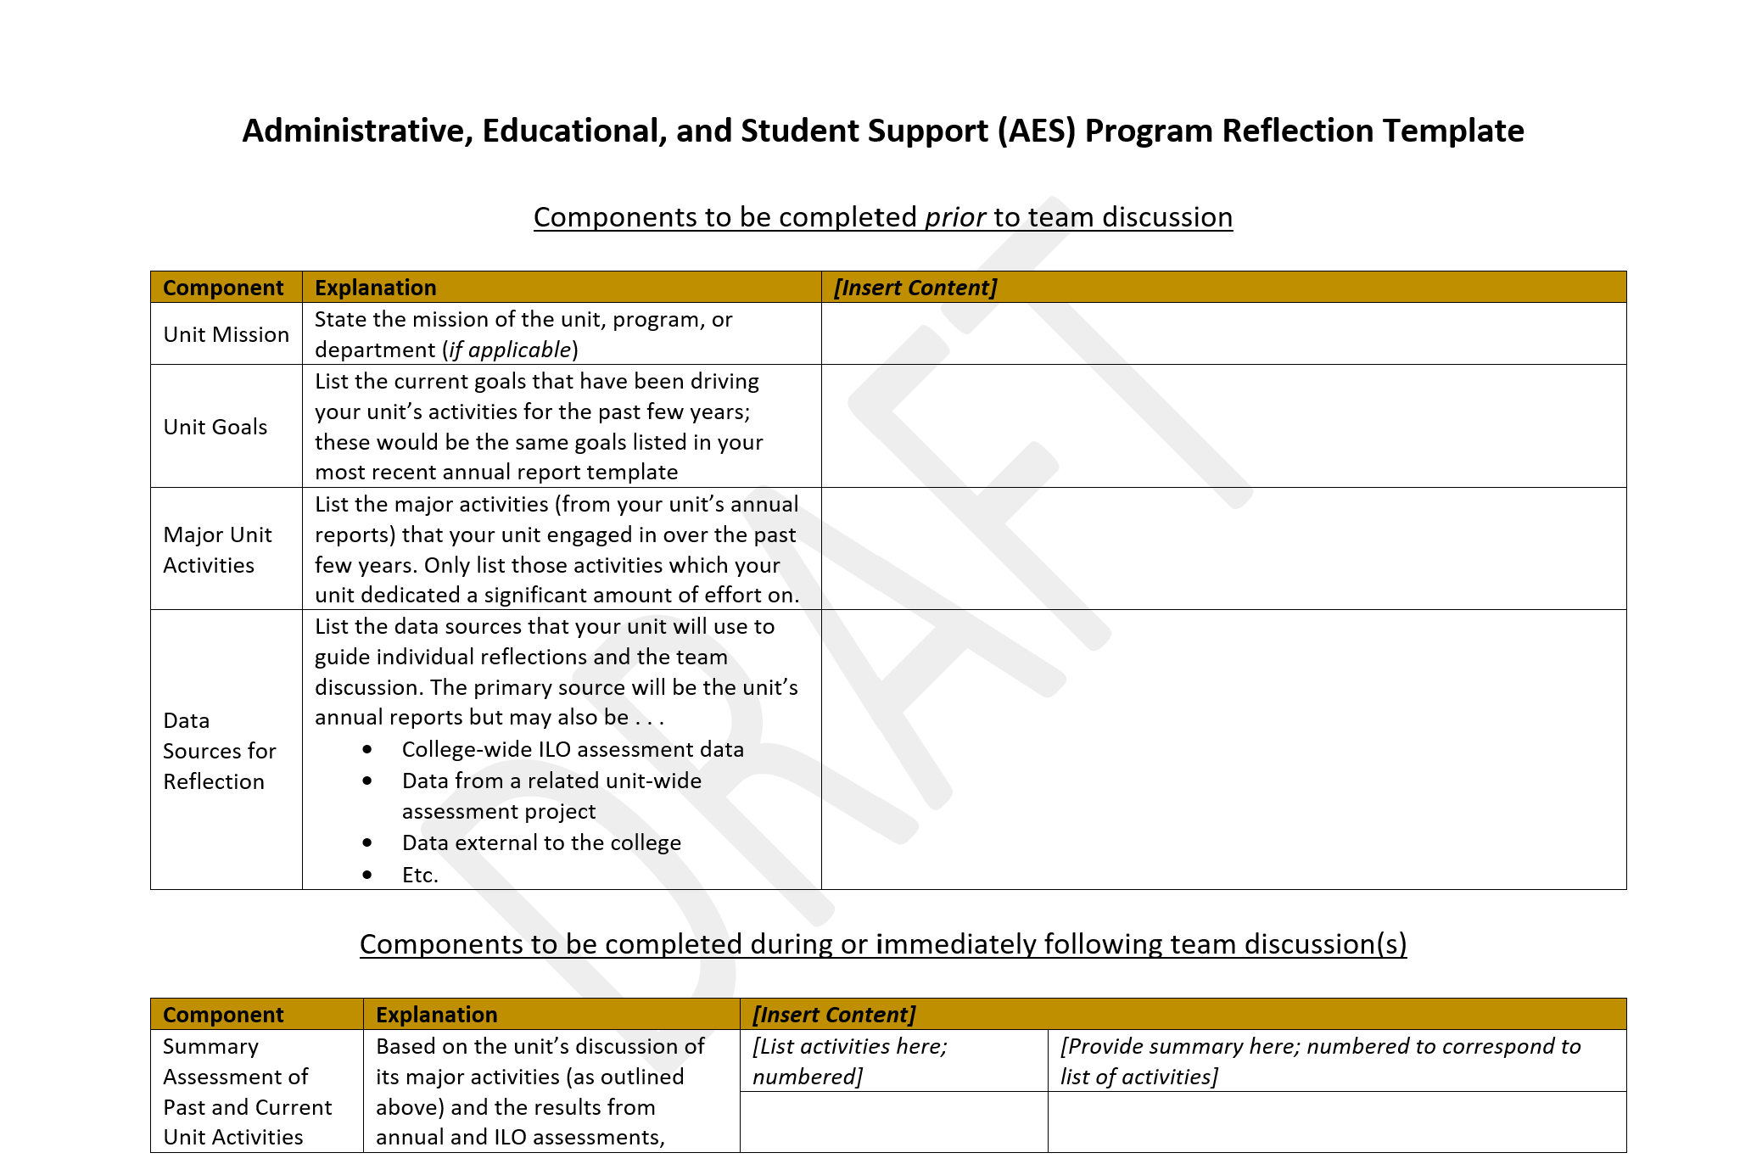
Template Document
Notes:
NOT going to go in depth on each document, but you should have received 3 of these documents yesterday . . .

Slide 20
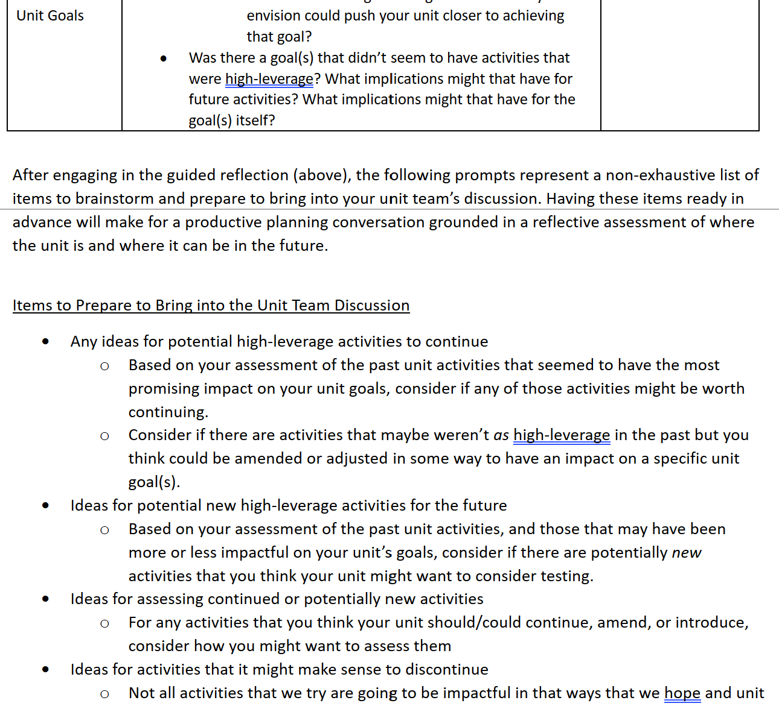
Guiding Questions for Reflection

Slide 21
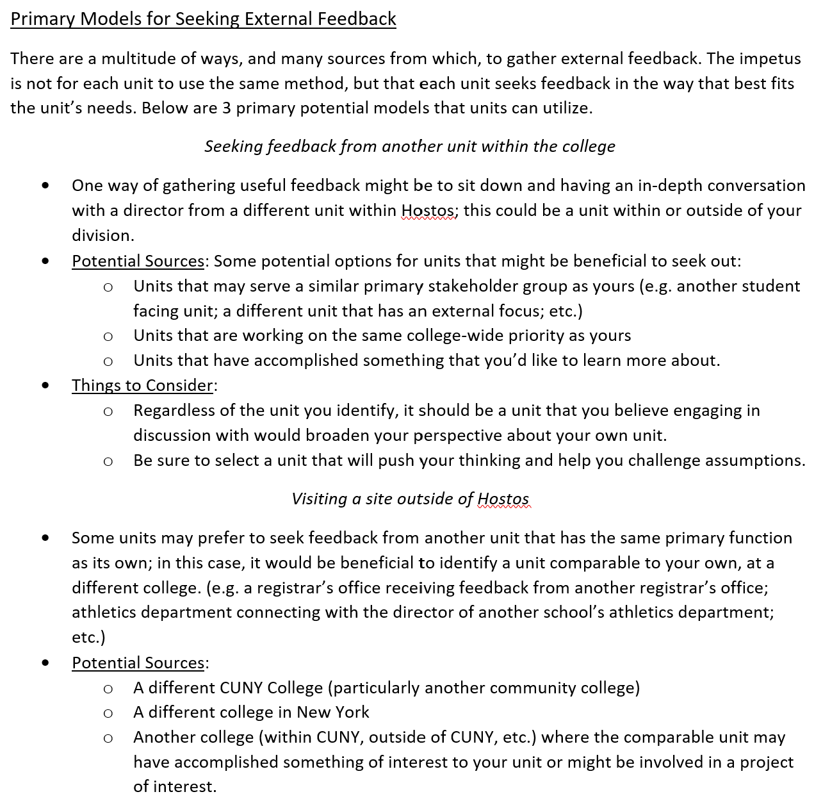
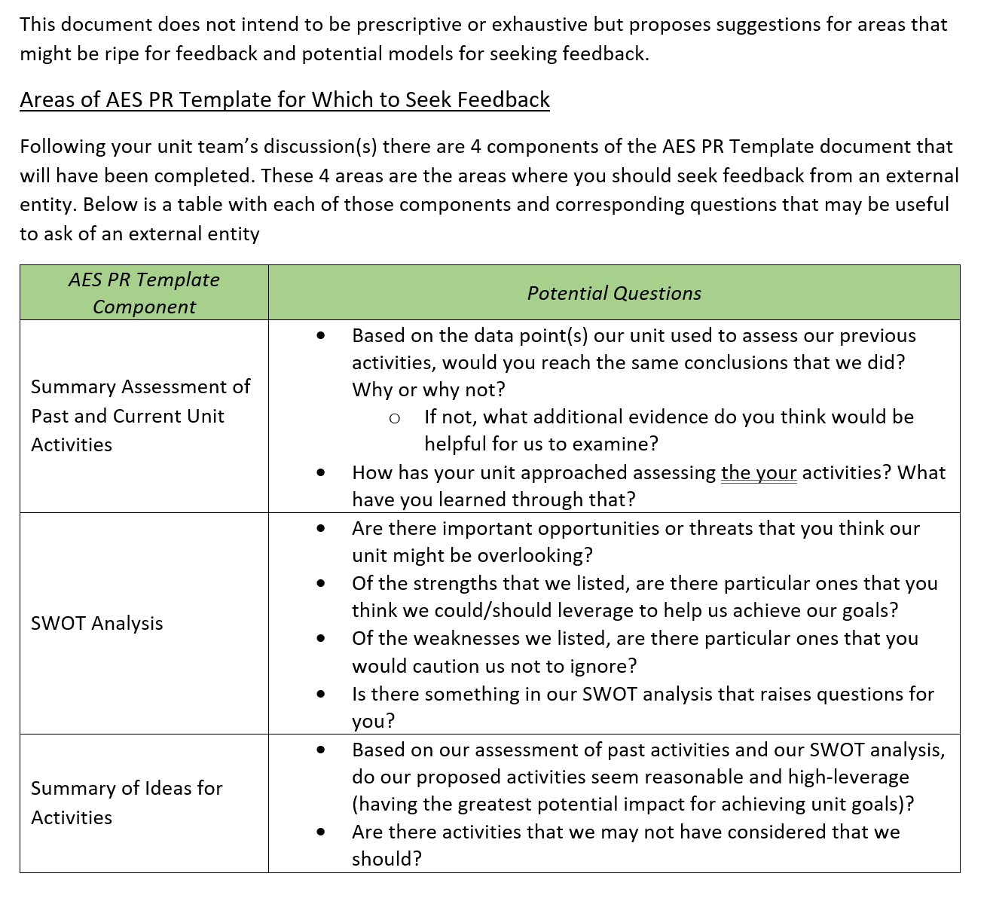
Guidance Document for External Feedback

Slide 22
Supports for the Process – Support Structures
Entity | Role
OIERA | Develop and communicate resources to support the AES PR process Provide training and support to unit, department, or program leadership undergoing AES PR Provide data guidance and support, as needed
AES Assessment Committee | Provide AES PR consultation to units as needed Collaborate with OIRA in offering AES PR workshops and resources Collectively problem solve any barriers to the process and develop solutions to improve the process for AES units
AES Unit Cohort/ Cohort Support Plan | Collectively brainstorm potential approach to the AES PR process Share drafts, examples, and ideas with each other to help each other strengthen their AES PR Process Act as an additional resource to call upon and share challenges and successes with each other, thereby creating community
Notes:
The last thing I’d like to highlight is how the structures for supporting AES units through this process are markedly different than in the past . . .
OIERA is still part of the support structure for this process, as has always been the case.
But to augment and improve what the support looks like, 2 new structures have been developed:
A newly formed AES Assessment Committee, whose primary charge is to (Read bullets) . . . More brains are certainly better than one and having the different perspectives and on the ground knowledge of how the process is working, will benefit everyone.
A cohort model structure for AES units that are undergoing their AES PR Process. In the former process, there were training workshops . . . But a scaffolded cohort model approach will guide units through each of the steps of the process, providing support guidance, and collaboration before diving into each step (via a few cohort meetings with clearly outlined goals)
The units that are undergoing this process this Fall (IF YOU HAVEN’T HEARD FROM ME, YOUR UNIT IS NOT SCHEDULED FOR THIS FALL), will be kicking this off soon.

Slide 23
Question and Answers
Notes:
I’ve done a lot of talking and shared a lot of information, and I’d like to hear from you now.
What questions do you have?
What reactions do you have?
What resonates most with you about this redesigned AES PR process

Slide 24
EXIT POLL
Notes:
I want to thank you all for joining the webinar, but before you go . . . I’d like to get a quick poll of where people are landing after this webinar, to help me determine what might needs to be improved or clarified in the future.

Slide 25
Thank You!

